Slide 1
Monday, December 19, 2016
Write In Your Agenda:
Write In Your Monitoring Log:
CW:
Tides and Eclipses.
Final Review.
HW:
Looking for donations of Oreo cookies for moon phases activity.
Response to Warm-Up:
Name 4 phases of the moon.
You will need:
Pencil

Slide 2
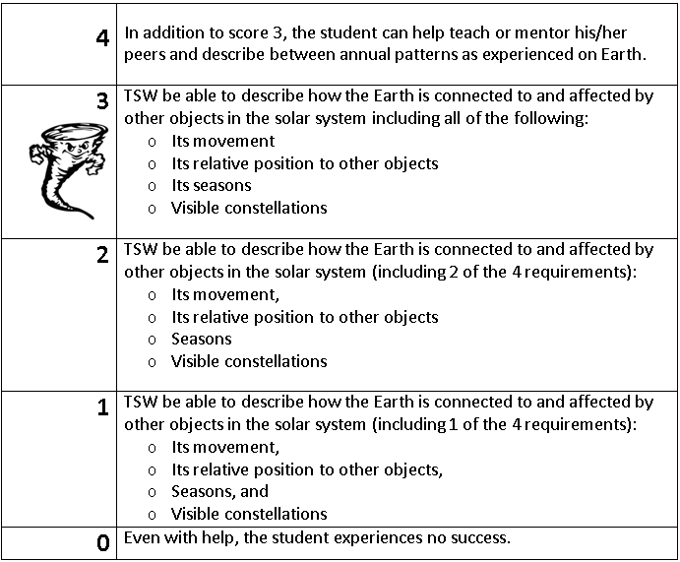
Learning Goal and Scale
TSW be able to describe how the Earth is connected to and affected by other objects in the solar system (including its movement, its relative position to other objects, its seasons, and visible constellations).

